Slide 1
Understanding Anxiety in Children
Becky Cumming & Kate Perry
Primary Mental Health Specialists
South Bristol CAMHS
May 2019

Slide 2
What we plan to cover:
What is anxiety?
When is anxiety a problem?
Causes of anxiety and what keeps it going
What parents can do to help
Resources

Slide 3
https://themighty.com/video/phrases-kids-said-that-were-code-words-for-im-anxious/

Slide 4
What is anxiety?
A normal response to stress
It usually passes
Can be protective – alerts us to danger
Can help us perform e.g. exam/ competition
Most children learn to cope with different fears and worries

Slide 5
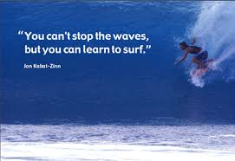

Slide 7
https://www.youtube.com/watch?v=mtRrxNTnyh8

Slide 9
Common fears by age
Babies – stranger anxiety
Toddlers – separation anxiety
3 years olds – afraid of dark, sleeping alone, dogs
4-6yrs - anxiety not based in reality (monsters, ghosts)
7-12yrs – more aware of real world issues, death, real circumstances that could happen (bodily injury, natural disaster).

Slide 10
When is Anxiety a Problem?
When it is too strong for the child to bear.
When it lasts once the threat has gone.
When it leads the child to avoid or pull away from activities/ school etc.
When it causes ongoing physical symptoms.
When they keep seeking reassurance but it has no effect.

Slide 11
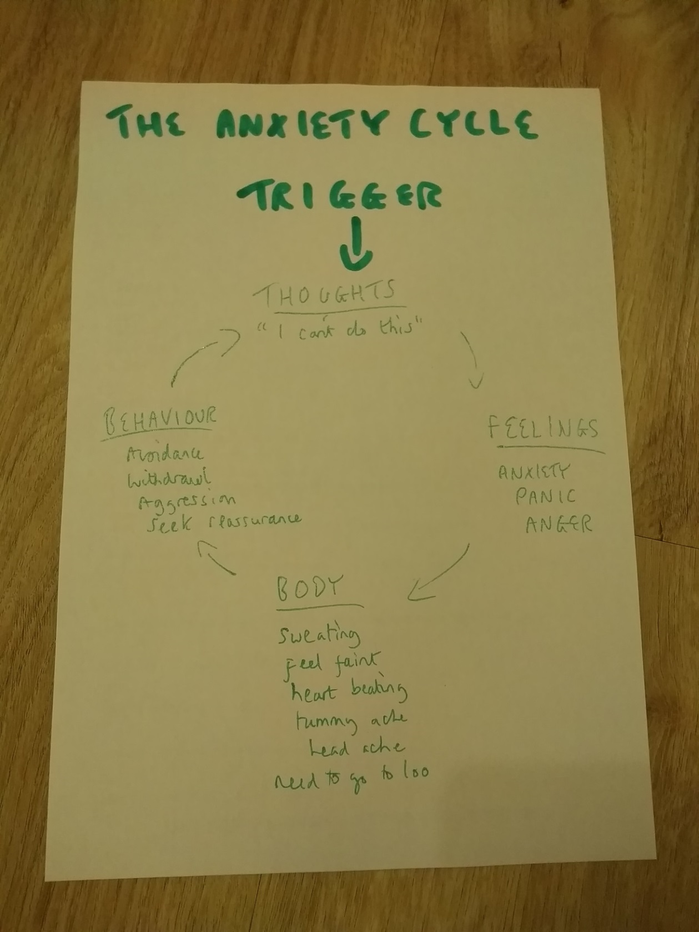

Slide 12
Avoidance!
Is your child avoiding situations that make them anxious?
Are they missing activities due to tummy aches/ headaches etc which may be due to anxiety?
Avoidance is an understandable reaction but makes things worse in the long term.
What helps: help them to face the situation in small steps.

Slide 13
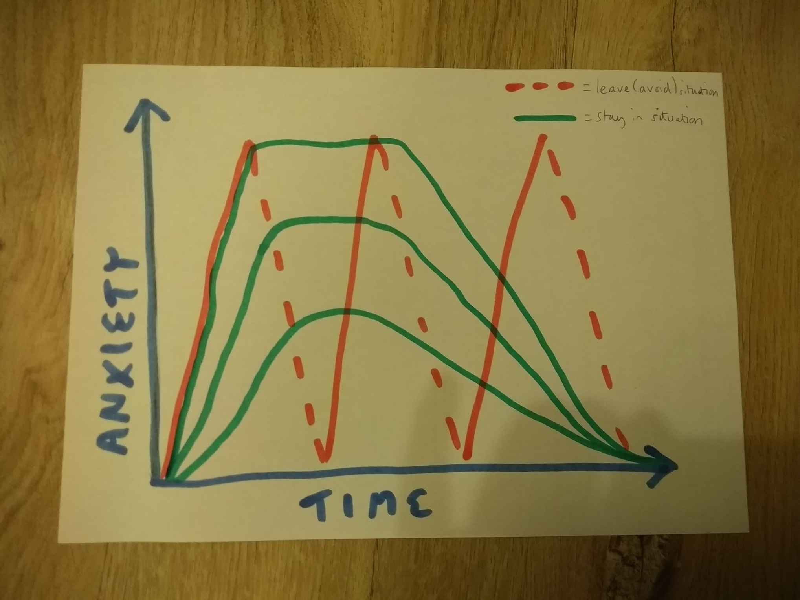

Slide 14
Manage Expectations
Remind your child that facing the fear in small steps will help…
But there may be “bumps” a long the way
The best way to help is to keep going with facing the fear in small steps.

Slide 15
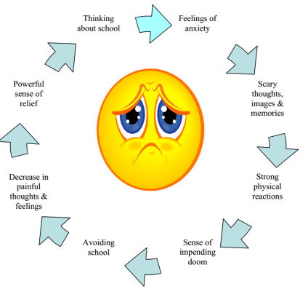
Avoidance cycle

Slide 16
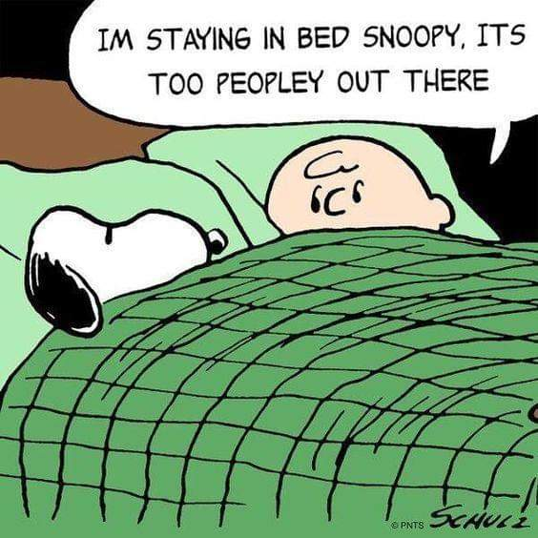

Slide 17
What contributes to anxiety?
Genes and temperament may have an influence
Anxious beliefs
Parent/carer reaction
Avoidance
Life stressors

Slide 18
Stressful events that may contribute to anxiety
This includes moving home/ school often.
Being in an accident/ serious illness.
Parents fighting or arguing.
School issues e.g. bullying/ exams.
Loss of someone close to the child.
Being close to someone else who is anxious

Slide 19
What Keeps Anxiety Going
Our thoughts? E.g. “I know I’m not going to manage in school today”.
Behaviour: Our reactions/ what we do, including avoiding/ staying away from the thing that makes us scared or seeking a lot of reassurance
Sometimes adult’s reactions to the child’s anxiety, and the child’s reaction to this.

Slide 20
How to Help: Understanding Anxiety
Really important children understand what is happening inside their bodies.
Tell them these symptoms are your body’s way of telling you how you’re feeling.
Notice when they start to complain of headaches/ tummy aches – remind them their body might be telling them their anxious.

Slide 21
Anxiety

Slide 23
Helpful/unhelpful thoughts

Slide 24
Examples of Unhelpful thoughts
I am going to fail that exam
I have no friends
I am worried someone in my family will get ill
I wish I was someone else
I am not going to like this
I can’t talk in front of the class
Everything goes wrong because of me

Slide 25
Challenging unhelpful thoughts
Is this thought helpful?
How do you know this is true?
Is your brain exaggerating here?
How can you make this unhelpful thought into a helpful one?
Are there any times this worked out differently?
What would your best friend say to you if they knew your thoughts?

Slide 26
How to support your child
Help your child feel safe & secure at home
Praise & reward for even small steps or effort
Give clear & firm limits (don’t back down!)
Try to be patient .
Don’t give too much reassurance – X 1 only.
Support your child to face the fears – with small steps if needed (avoid avoiding!)
Be thoughtful about what you share with your child

Slide 27
strategies

Slide 28
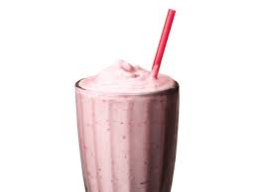
Milkshake breathing
Get a plastic cup with a straw.
Fill the cup 1/3rd full with water. Ensure child breathes in deeply through their nose and breathes out slowly through the straw. Encourage them to blow SMALL bubbles in the cup very gently.
Have your child practice at least five times

Slide 29
Tracing fingers
Inhale through the nose & trace the outside of his thumb, then exhale through the mouth while tracing along the inside of the thumb. Inhale & trace the outside of his pointer finger, exhale while tracing the inside of his pointer finger…& so on and until all the fingers have been traced.

Slide 30
Square breathing

Slide 31
Special Relaxing Place
Think about your relaxing place and draw or describe it. This could be a real place you
have been or a picture you may have created in your dreams.
_ Think about the colours and shapes of things.
_ Imagine sounds – seagulls calling, leaves rustling, waves crashing on the sand.
_ Think about the smell – the smell of pine from the trees, the salty sea, cakes baked
fresh from the oven.
_ Imagine the sun warming your back or the moonlight shining through the trees.
This is your special relaxing place. To practise using your relaxing place:
_ Choose a quiet time when you will not be disturbed.
_ Shut your eyes and imagine your picture.
_ Describe it to yourself in lots of detail.
_ As you think of your picture, notice how calm and relaxed you become.
_ Enjoy it and go there whenever you feel anxious.
Remember to practise.
The more you practise, the easier you will find it to imagine your picture
and the quicker you will become calm.

Slide 35
Sensory Calmer’s
Weighted/deep pressure/calming equipment
Weighted blanket
Weighted animals/shoulder snake
Large ball
Tactile equipment
Rice/bean/corn flour
Sensory ball
Silly putty
Moon sand
Oral Motor
Bubbles
Some may need the opposite – quiet, space

Slide 36
Self Calming and Relaxation Strategies
-walk, push a wall, slow breathing, stretch, foot massage
-drawing, colouring, calm music
-Visualising worry box
-Lotion smoothies

Slide 37
The worry Box
Kleenex box, decorate it
Write down worries put in box/ picture
Everyday take out worries one by one
Discuss them, problem solve.
If still a worry go back into box
If not rip it up and put it into a box

Slide 38
Applying today’s ideas and resources to your practice
What has made you stop and think?
What do you want to learn more about?
What one thing are you going to do differently from today?

Slide 39
Other Help
Young Minds helpline: 0808 8025544 (Monday to Friday)
Off the Record Parent Phone Line (age 11 up) 0808 808 9120 (Mon-Fri, 2-5pm).
Off the Record Parent Drop In 2nd Wednesday of every month – 6-7.30pm
What to do When You Worry too Much (workbook)
https://youngminds.org.uk/find-help/for-parents/parents-lounge/ - Managing Anxiety in Children – 20 mins clip

Slide 40
https://youngminds.org.uk/find-help/for-parents/parents-lounge/ - School Refusal clip
http://edocs.southglos.gov.uk/download/successfullymanaginganxietyinformationforchildrenandyoungpeople_601.pdf Online Anxiety Toolkit from South Glos council.
Stop, Breathe, Think Kids – mindfulness app (5-11)
https://www.smilingmind.com.au/smiling-mind-app Mindfulness app (free!)

